Slide 1
EndNote @ Pitt: Teaching with Technology
WPWVC/ACRL Spring Meeting
Morgantown, WV
June 6, 2013
Leslie Eibl & Anne Schwan ,
Visiting Librarians
University of Pittsburgh
Image: “Technology in the Classroom”, Barnard University, http://barnard.edu/headlines/syllabus-technology-classroom

Slide 2
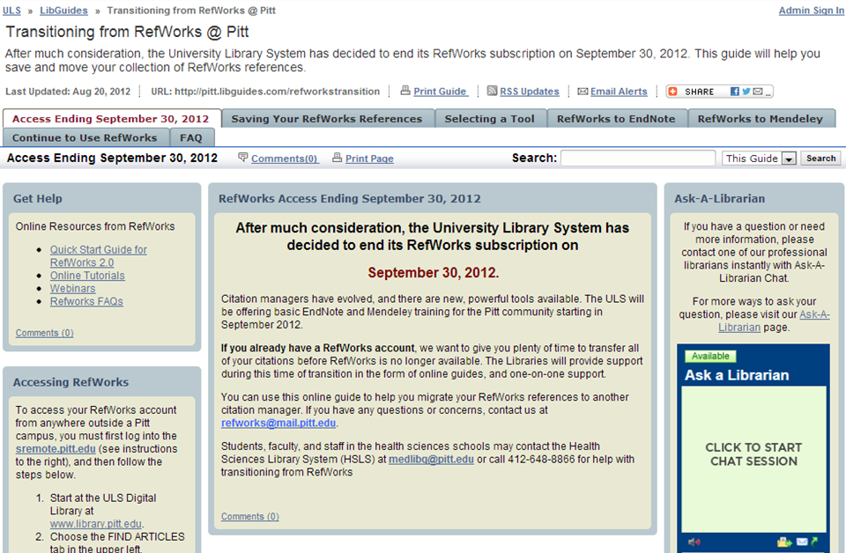
EndNote @ the ULS
The University Library System transitioned its support from RefWorks to EndNote in the Fall of 2012
Librarians created a LibGuide to assist students and faculty with the transition
http://pitt.libguides.com/refworkstransition
Since November, 2012:
14 Scheduled Endnote Sessions
9 General / Open to University Staff, Faculty, and Students
1 Benedum Hall for Engineering Staff, Faculty, and Students
2 Liaison Librarian Training Sessions
2 Dissertation Boot Camp Sessions

Slide 3
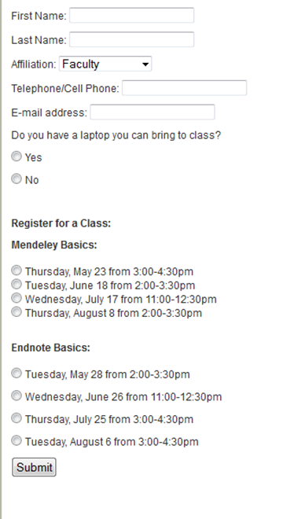
Outreach Efforts
@ Hillman:
Sign up online
Facebook ads
Registration follow-up emails
@ Engineering:
Contact graduate student coordinators and department heads
Circulate email announcements
Facebook ads
Registration follow-up emails
Screenshot of Session description and Sign-up form on the ULS website
http://www.library.pitt.edu/services/classes/infoliteracy/citation_training.html

Slide 4
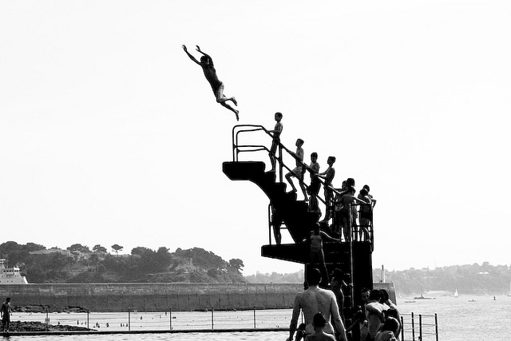
Learning the Software
Dive
right
in!
“Jumping off the diving board” http://www.flickr.com/photos/moonsq

Slide 5
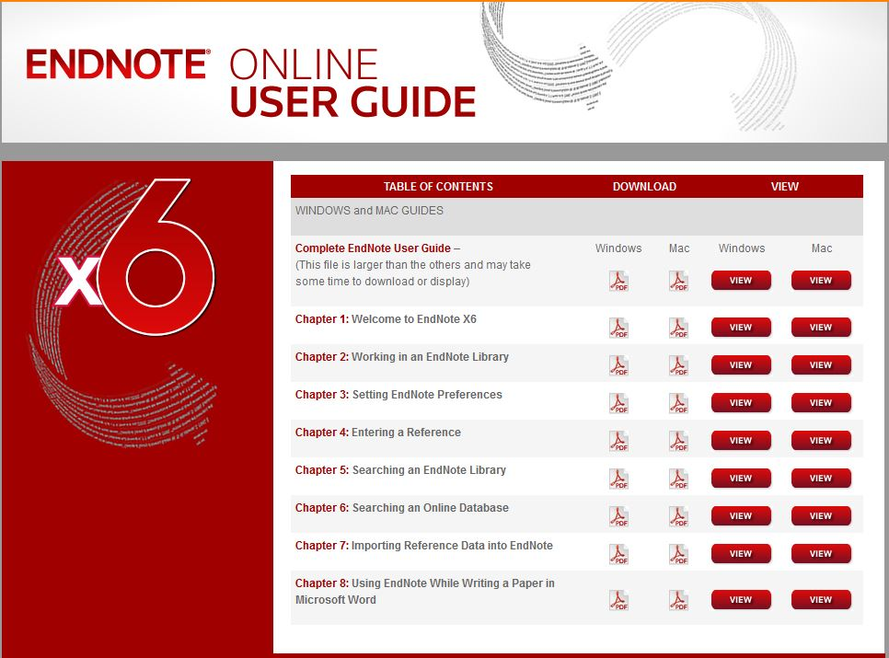
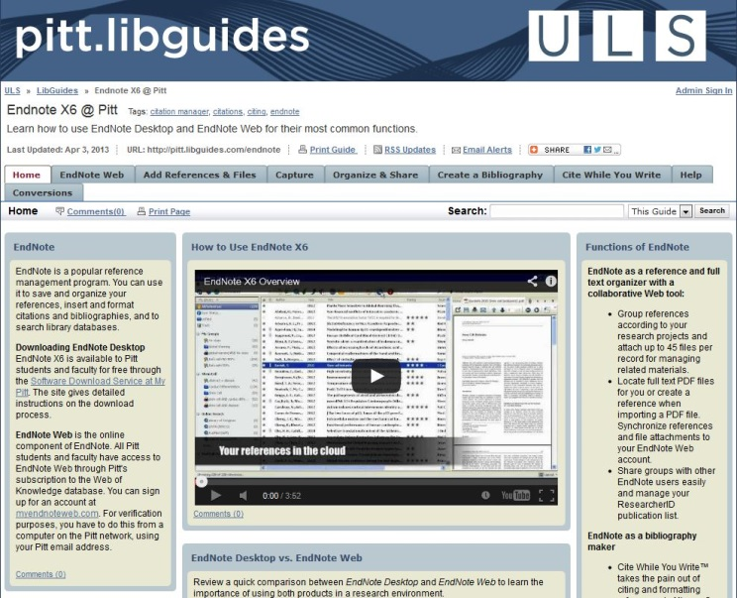
Learning the Software
EndNote Training materials online
http://endnote.com/if/online-user-manual
ULS EndNote LibGuide
http://pitt.libguides.com/endnote
HSLS Training materials
http://www.hsls.pitt.edu/howdoi/category.php?id=9
Other University libraries

Slide 6
Different Populations, Different Needs
“How do I open EndNote on my computer?”
“How do I generate and manage Bib TeX files for use with La TeX?”
And everything in between!

Slide 7
And this is just the Desktop version…

Slide 8
Developing a Script
To turn the “Wah Wah Wah” effect in the “WOW” effect, developed script that:
Is conversational in tone
Has multiple entry points for student comments and questions
Incorporates information literacy elements
http://www.98togo.com/Portals/121593/images/charlie-brown-whawah.jpg

Slide 9
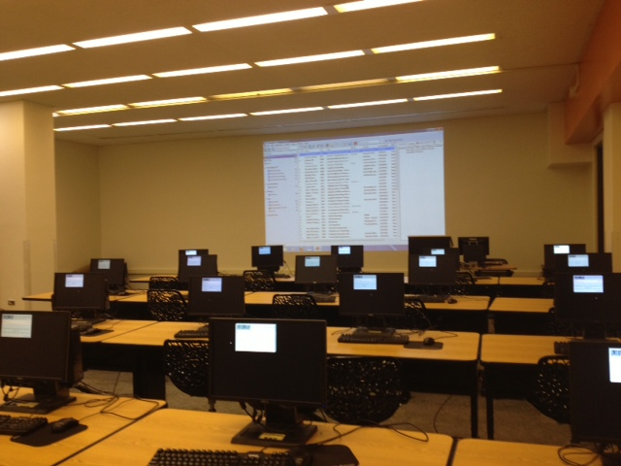
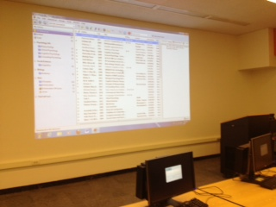
Teaching & Technology Considerations
Teaching Technologies
We encourage the use of laptops
Technology will go wrong!
Keeping on task
New Hillman Instruction Area

Slide 10
Outcomes & Assessment
13 students were surveyed over 3 Hillman sessions
“This was a very helpful session, I learned a lot more about Endnote than I had previously. The session was hands-on which was most important and the learning space was very sufficient and conducive to the task at hand.”
“Instructor was very helpful, especially with audience questions.”
“EndNotes should be installed on desktop computers, for participants who don't bring a laptop (but I was lucky that it was installed on the one I used!).”

Slide 11
Future Considerations & Improvements
Streamline RSVP process ensuring attendance
Assessment!
Offering advanced sessions
Screencasting

Slide 12
Suggestions & Questions?
Anne Schwan ads114@pitt.edu
Leslie Eibl leibl@pitt.edu
Bibliography “http://www.flickr.com/photos/papertrix/38028138/”

